Slide 1
CSCI 2270 PROJECT OUTLINE:
~AVENGER MAZE TRIVIA!~
Clint Eisenzimmer
Artem Nekrasov
Blaine Rubenson

Slide 2
~STORYLINE~
Across the cosmos dwells a dark power which slowly starts to eclipse the light of a nearby star!
The “EMPTY”, as they call it, devours all in its path.
Its goal? To wipe out all existence, matter, and life if not controlled!
There is no escape; no place to run or hide.
The “EMPTY” only obeys one master.
He goes by the name of Thanatos.

Slide 3
~STORYLINE~
Thousands of years and countless failures yielded a frightening result when the “EMPTY” was born--a weapon like no other--allowing Thanatos to continue his vision of keeping only half of the universe alive!
After his first successful extermination of life via the infinity stones,
he now seeks to maintain order and balance in his new universe.

Slide 4
~STORYLINE~
The new unlikely Hero has found out about Thanatos’s master plan!
With the Avengers scattered, missing, and some presumed dead, it is up to our new Hero to save the galaxy.
Our brave Hero will work to free the galaxy from Thanatos’s grip!

Slide 5
~GAME OBJECTIVE~
To win the game, our Hero must navigate through the maze, and answer the trivia questions to find and defeat Thanatos--saving what remains of the galaxy and freeing all existence from oppression!

Slide 6
~GAME PLAY~
The Player starts at the beginning of the Maze, and traverse it by moving 1 planet/node per turn in any direction. They can take a number of paths to reach Thanatos, before the “EMPTY” eats them alive!
Once a Hero has landed at a planet, a challenge/question will appear for them to work out.
If they succeed, they get to go again and choose another direction. Otherwise, the player’s turn ends, the the computer gets to move, and Thanatos’s “EMPTY” eats a planet.
There are dead ends, and Thanatos spawns at a random location every new game. The Player will sometimes encounter traps/minions that will try to stop them along the way! The game ends when the “EMPTY” consumes all existing planets, or when the player encounters Thanatos and loses the challenge. If the player completes the final challenge against Thanatos, the Heroes win, saving the universe from oppression!

Slide 7
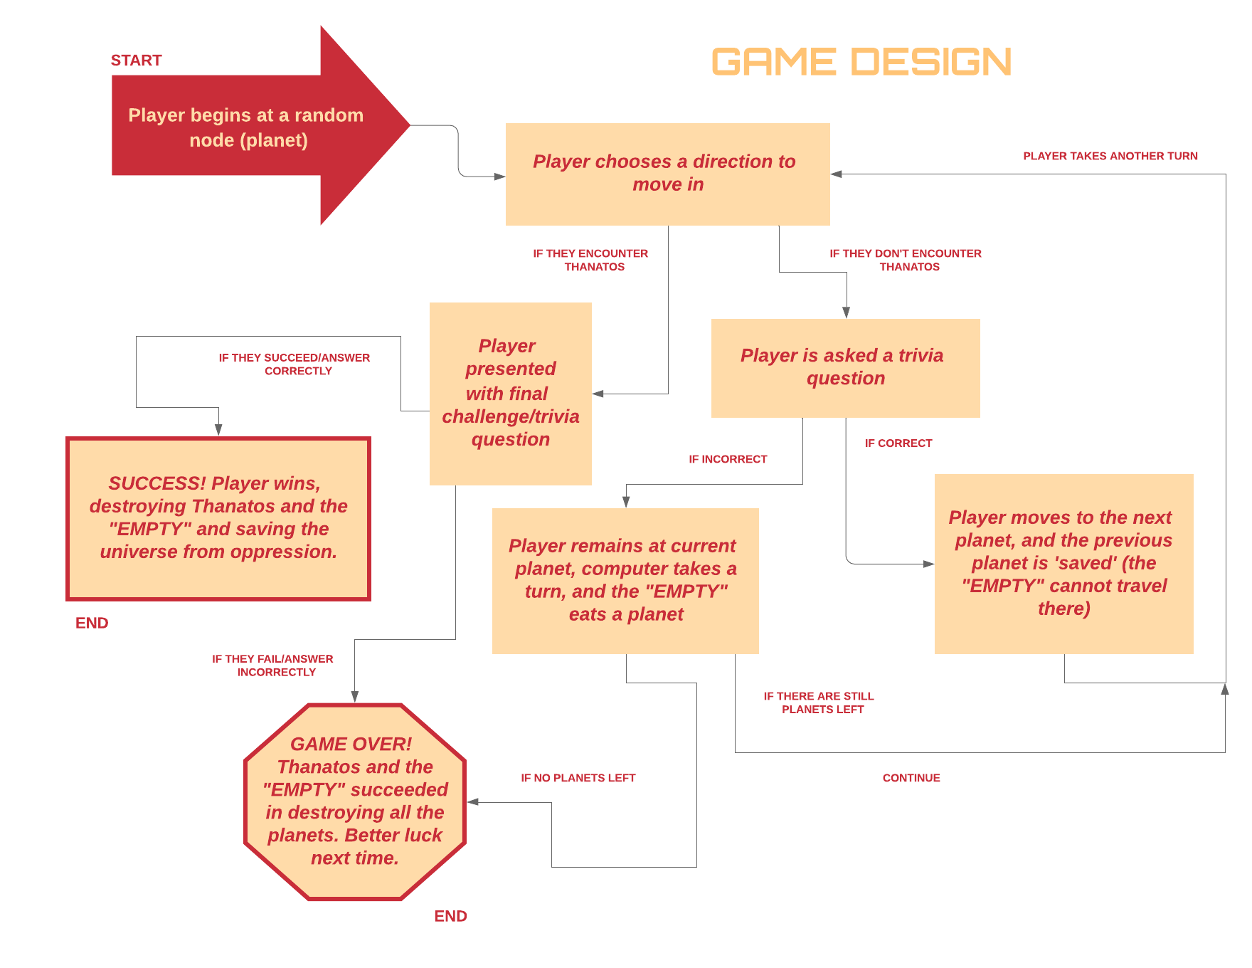

Slide 8
~DATA STRUCTURES USED~
Dynamically sized unDirected Graph using an array of vertices and an array of edges to link.
The graph is used for the player to go to and from nodes (planets).
It represents a maze which is randomly generated and also destroyed as the enemy deletes nodes (destroys planets).
Trivia Questions will be stored in vectors which will provide the challenge/question to the player when trying to move from one vertex to another.
In each vector list there will be a list of questions that can be asked randomly, which will look at the these questions and then display one for the player to answer.

